Slide 1
Your Data Science Future
Statistics, Courses, Programming Languages, and Future Developments in Tech

Slide 2
Required Skills
Job Titles
Programming Languages (Python, R, SQL, SAS, C/C++, Hadoop, Java, Matlab, etc.)
Technical Writing
Soft Science Expertise (Business, Finance, Neuroscience, Biology, Sports, etc.)
Communication
Mathematics/Statistics/Machine Learning
Data Mining/Cleaning
Data Visualization
Data Scientist
Data Analyst
Business Analyst
Financial Analyst
Statistician
Operations Research Analyst
Data Architect
Data Engineer

Slide 3
Data Science is Lucrative
Notes:
Source: Glassdoor

Slide 4
Data Science is Lucrative
Notes:
Source: Glassdoor

Slide 5
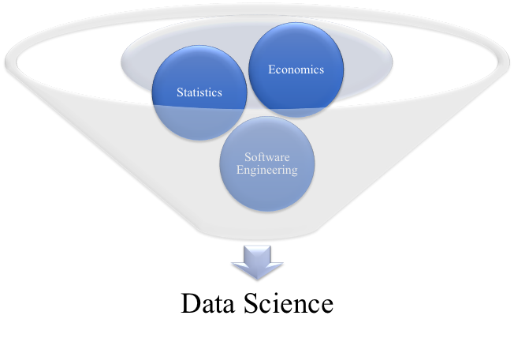
Data Science Courses

Slide 6
Course Notes
Number or Question Mark before title denotes when to take it relative to others
“?” denotes you should take it anytime after the numbered courses but based on personal preference
More “?”s means you should have more prerequisites before taking the class than less “?”s
Letter after course number denotes how important this course will be likely in your career
A most important, E least important
Just because a course is needed as a pre-requisite for another course doesn’t mean you will need to use it more than the course that comes after it
Ie: Calc 2 is often a pre-requiesite for Calc 3; however Calc 3 is much more likely to be used than Calc 2 in data science work

Slide 7
Computer Science Lower Levels
1st - Introductory Computer Programming (A)
Often in Python
How to write and debug code
How to manage program complexity and learn basic programming knowledge
2nd - Data Structures and Algorithms (A-)
Often in Java
Deals with tradeoffs in time and memory with structuring data/programs
How to construct and analyze larger programs
? - Computer Architecture (C+)
Often in C++
How machines execute programs and deal with memory
? - Discrete Mathematics (B-)
Often introduces proofs and introduces math used in higher level CS courses without taking a semester deep dive into such topics in their actual courses

Slide 8
Computer Science Upper Levels
? - Artificial Intelligence (B-)
Introduction to AI and how machines mathematically construct and “win” games, MATH HEAVY
? - Databases (B)
How to store, access and file systems for data
? - Algorithms (C)
How to solve problems more efficiently, MATH HEAVY
?? - Machine Learning (B+)
How to build models that explain patterns in large amounts of data, VERY MATH HEAVY
Requires Linear Algebra, Probability, Calc 3, sometimes Advanced Linear Algebra
??? - Natural Language Processing (D)
The study of computing systems which process human languages, take after Machine Learning, VERY MATH HEAVY

Slide 9
Mathematics/Statistics Lower Levels
1st - Calculus 1 (B+)
One-variable Calculus
1st - Linear Algebra (A)
Matrix Algebra, vector spaces and linear equation solving
Often helpful to have a proofs course or experience in math to take before though
2nd - Calculus 2 (E)
Integration applications and series
Often prerequisite for Calculus 3
3rd - Calculus 3 (A-)
Multi-variable Calculus and vectors
4th - Probability Theory (A)
Set theory and fundamental uses of mathematics in probability
Often requires Calculus 3

Slide 10
Mathematics/Statistics Upper Levels
?? Operations Research (B+)
Optimizing, linear programming and making decisions under uncertainty
?? Statistical Inference (C)
Mathematics behind sampling distributions, hypothesis testing, regression, inferential methods, etc.
?? Advanced Linear Algebra (D-)
Rigorous proof based analysis of Basic Linear Algebra
?? Time Series Analysis (D)
How to mathematically analyze a sequence of data points collected over time

Slide 11
Economics/Finance/Other
1st - Introductory/Applications of Data Science (A+)
You are Here!
1st - Introductory Microeconomic Theory (B+)
The study of the allocation of resources from an individual level
1st - Introduction to Finance (C)
? - Introductory Macroeconomic Theory (E)
How society makes due with limited resource availability
Often a prerequisite for other Economics/Finance/Business courses
? - Game Theory (D+)
Mathematical view on strategic decision making
? - Econometrics (B+)
Often in Stata
The design and estimation of economic models
A cross between statistics and economics

Slide 12
Computer Languages
Computer languages are structured from high (user-oriented) to low (machine-oriented). The lowest level of language is assembly, the machine’s native language. Python is a high level language while Java and C++ are relatively lower languages. Some “languages” like HTML aren’t actually languages but are actually markup, text formatting that structure web content. Clothes such as SQL are used to work with databases.
A good place to check the pros and cons of a computer language can be found at https://www.slant.co/topics/25/~best-programming-language-to-learn-first
Run time vs memory vs understandability vs functionality are important features that differ which make some languages more useful than others for different tasks.

Slide 13
Python (Development Language)
The Good
The Bad
Easy to get started, high level language
Many libraries of pre-made code
Good documentation and strong community user base to ask questions
Very similar to pseudo-code (resembles human logic well)
Relatively simple to learn
Easy to find jobs
Useful in many domains
Slow to execute
Does not teach about data types
Harder to pick up lower level computer languages
Harder to debug code due to low barrier to entry of use

Slide 14
Java (Development Language)
The Good
The Bad
Consistent programming standards
Excellent feedback errors with their integrated development environments
Most commonly used language in industry (not data science)
Many libraries and APIs with pre-made code
Too verbose
Lot’s of complicated language
Relatively steep learning curve
Garbage collection can lead to inefficiencies due to laziness in programming

Slide 15
C++ (Development Language)
The Good
The Bad
Large community and following
Lots of libraries
Powerful memory management
Excellent compiler optimization
Faster execution of much similar code than Java or Python
Great complexity/effeciency tradeoff
Overly complicated language
Relatively difficult to learn, low programming language (closer to machine)
Difficult to debug
Complicated types

Slide 16
R (Statistical Computing Language)
The Good
The Bad
Large community of users
Many packages and libraries
Excellent graphics and plotting packages compared to other languages
Widely used in Academia for its use in Statistics and Machine Learning
Less efficient with memory than Python
Relatively complicated to learn
Many packages and R itself are slower than Python and other languages

Slide 17
SQL (Database Query Language)
The Good
The Bad
Fast query processing
Large user base and documentation
Easy to learn
Very few coding skills required, mostly basic commands
Can sometimes only be accessed through complex interfaces (often only in Industry settings)
Sometimes not given complete control of all databases (often in Industry)

Slide 18
SAS (Statistical Analysis Language)
The Good
The Bad
Great debugging errors
Incredible with large databases
Fairly easy to learn
Portable with languages like SQL
Cost
Not open source (need license)
Poor graphical representation
Requires more lines of code than Python and R for some operations

Slide 19
Stata (Statistical Analysis Package)
The Good
The Bad
Easy to use
Paid professionals answer questions on Stata’s userboard (purchase of Stata required for access)
Some operations easier than Python/R
Cost (though cheaper than SAS)
Memory limitations
Not a programming language so applications outside of statistical analysis impossible
Poor graphical representation

Slide 20
HTML (Markup Language)
Basic building block of the web
Defines the meaning and structure of web content
Used in conjunction with CSS (changes web page’s appearance/presentation) and Javacript (changes web page’s functionality/behavior)
Can create your own websites!
Source: https://developer.mozilla.org/en-US/docs/Web/HTML

Slide 21
Data Science in Finance & Business
Corporate finance is quickly adopting the tools of data science as it continues to evolve
Forecasting future business performance and financials is quickly beginning to rely on machine learning and statistical modeling
Executives at F500 are more and more starting to turn away from excel as a presentation tool and moving towards Tableau and Power BI
The ability to automate and improve accuracy will be an invaluable skill in the business world

Slide 22
Weekly Readings/Videos
https://news.berkeley.edu/2018/05/31/those-four-wheeled-robots-on-campus-explained/
https://www.businessinsider.com/how-app-developers-keep-us-addicted-to-our-smartphones-2018-1#instagram-sends-dozens-of-push-notifications-each-week-and-uses-stories-to-attract-you-1
https://www.mentalfloss.com/article/520897/ai-program-wrote-harry-potter-fan-fiction-and-results-are-hilarious

